Slide 1
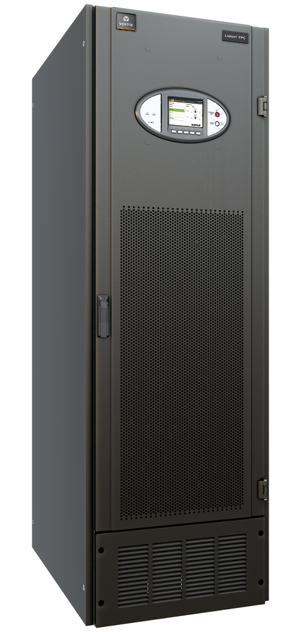
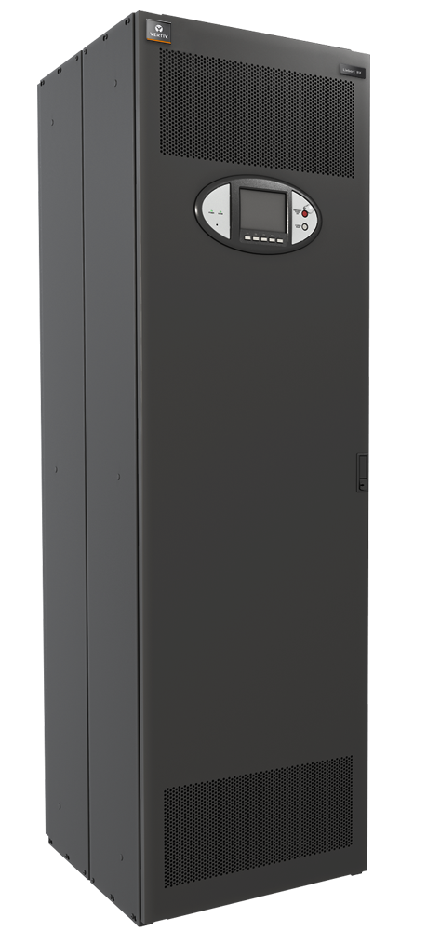
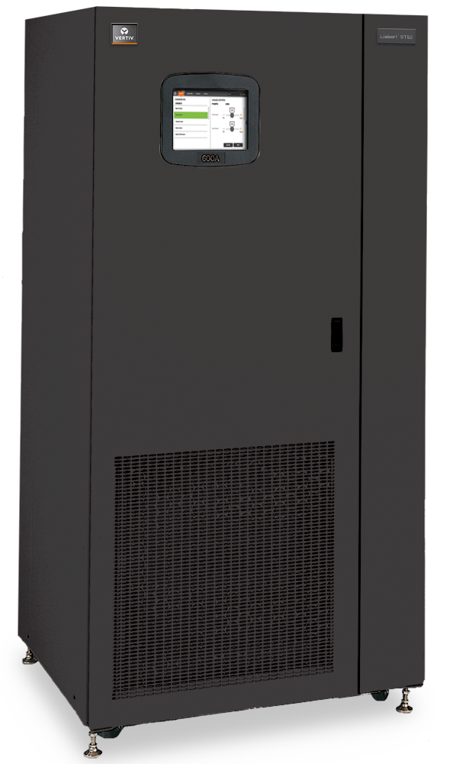
Liebert®
Power Conditioning and Distribution Overview

Slide 2
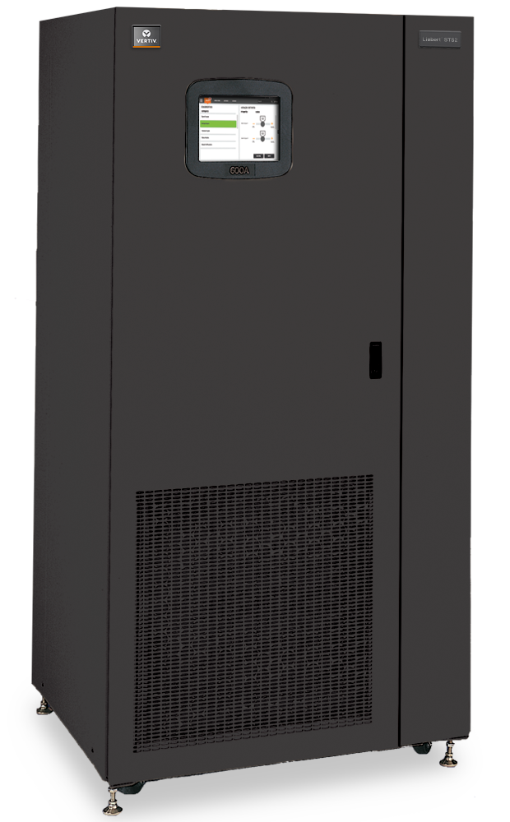
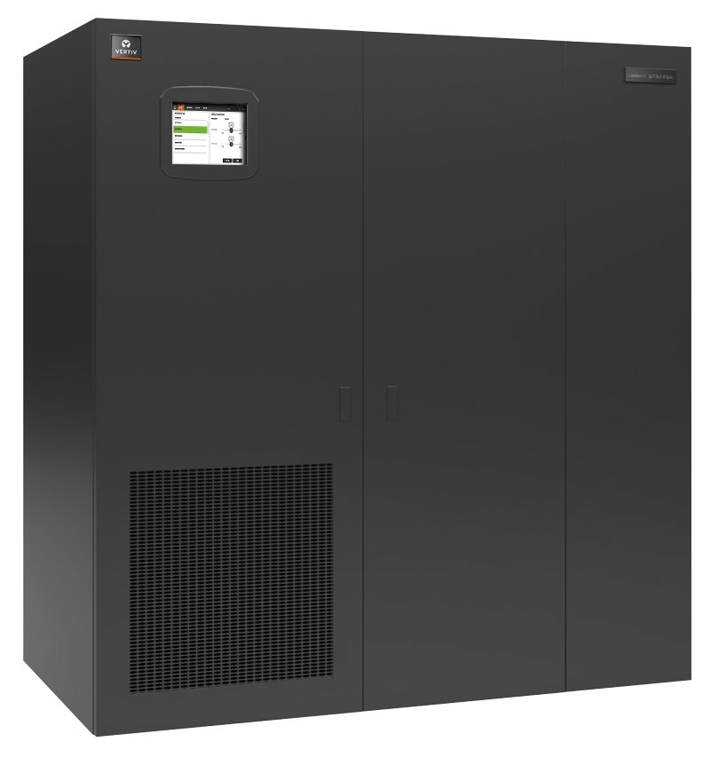
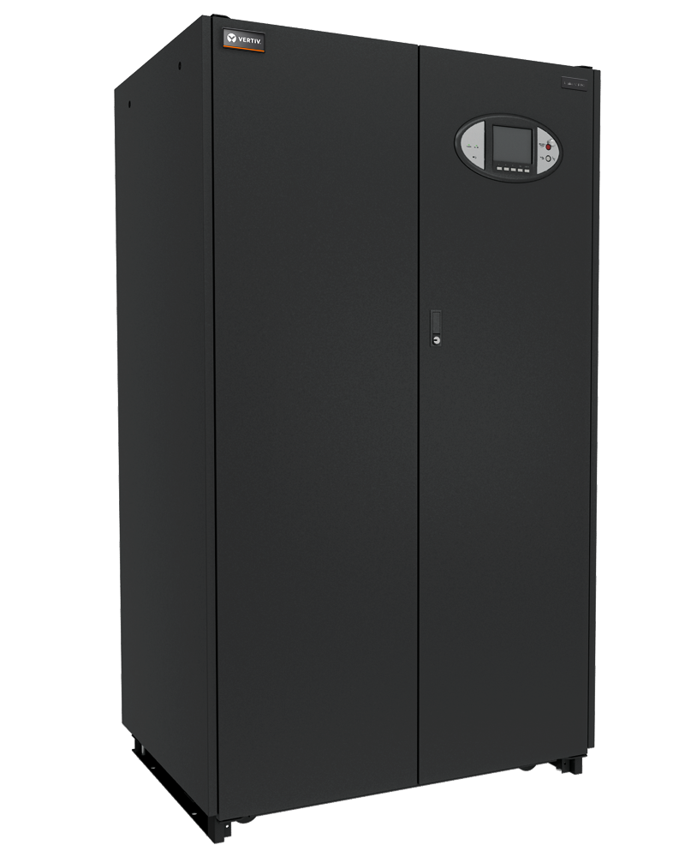
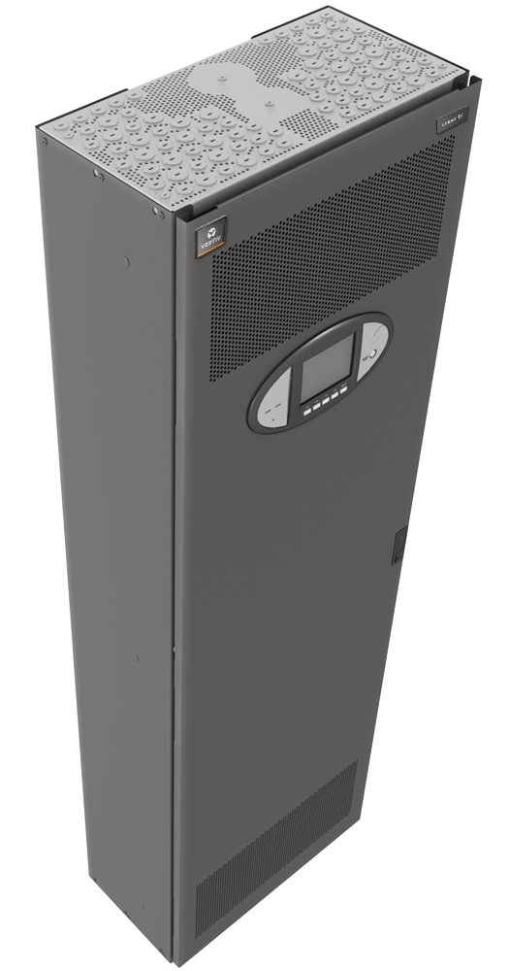
power conditioning and distribution products
Static Transfer Switches
Liebert STS2
STS2 (100, 250, 400, 600, 800, 1000A)
Liebert STS2/ PDU
STS2/PDU (250, 400, 600, 800A)
Legend
In Row
Transformer Based Distribution Center
Liebert FPC
In Room
FPC (15, 30, 50, 75, 100, 125, 150, 200, 225, 300kVA )
Liebert PPC
PPC (15, 30, 50, 75, 100, 125, 150, 200, 225, 300, 430, 500, 600, 700, 800kVA)
Distribution Panel
Liebert FDC
4 x 42 Pole Panel Boards
Liebert RX
1 x 84 Pole Panel Boards
Notes:
The power distribution and switching portfolio

Slide 3
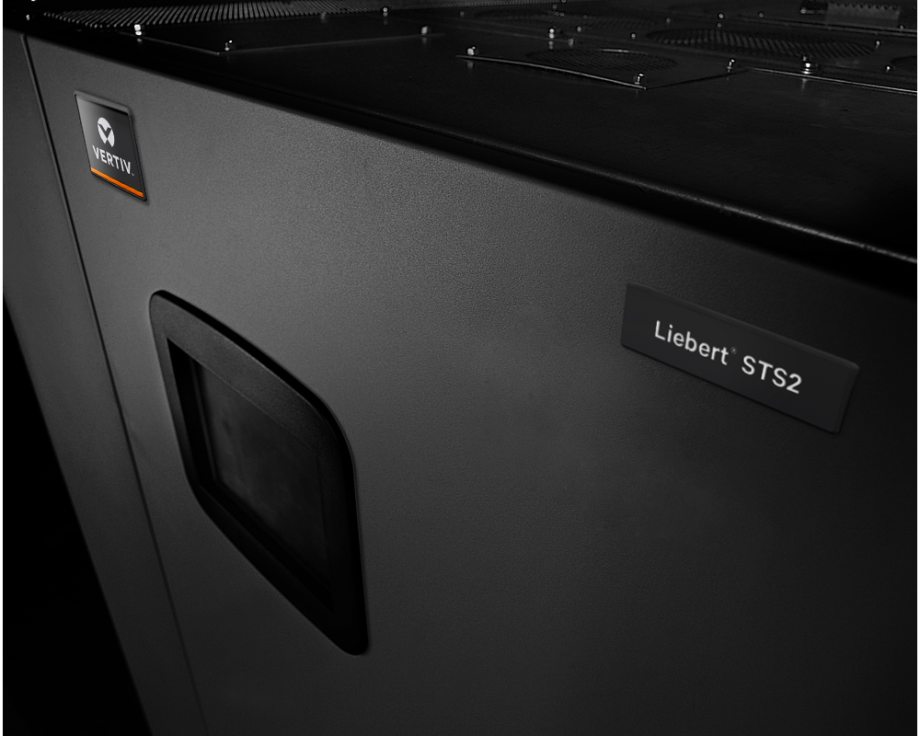
Room & Site Based Switching
Liebert STS2 Static Transfer Switch (STS)
Manual and automatic transfers between two independent AC sources
Fast, break-before-make switching with 1/4 cycle maximum transfers
Ratings: 100, 250, 400, 600, 800, and 1000 Amp 3-pole designs
Voltages: 208, 220, 240, 380, 400, 415, 480, 600 Volts, 50 or 60 Hz
Front-access only
Top/bottom cable entry
Integral maintenance bypass to both sources
Triple-redundant control logic with optional Liebert Optimized Transfer
Unique Optimized Transfer Capability
Most Reliable with 14 million hours of demonstrated MTBF

Slide 4
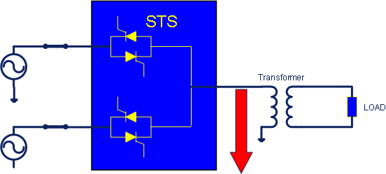
Background
Downstream transformers can cause large saturation current during automatic transfers
Trip upstream breakers
Or source failure due to overload
Transformer
Saturation
Currents

Slide 5
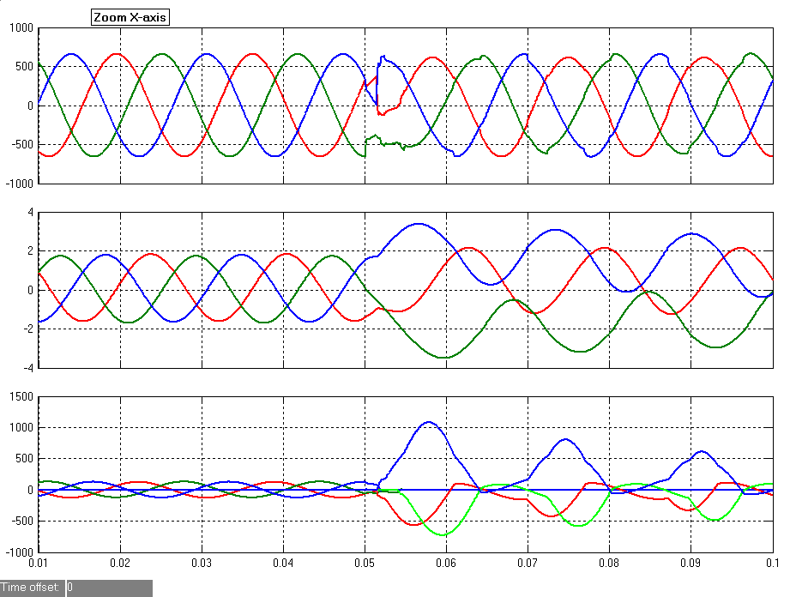
Transformer Saturation - a Primary Side Switching Problem
Transformer saturation is caused by dc-flux built up during transfers
Can happen especially when the sources are not in phase
Output
Voltages
Xfmr
Fluxes
DC-Flux
Build up
5x Or Worse Magnetizing Currents
Output
Currents

Slide 6
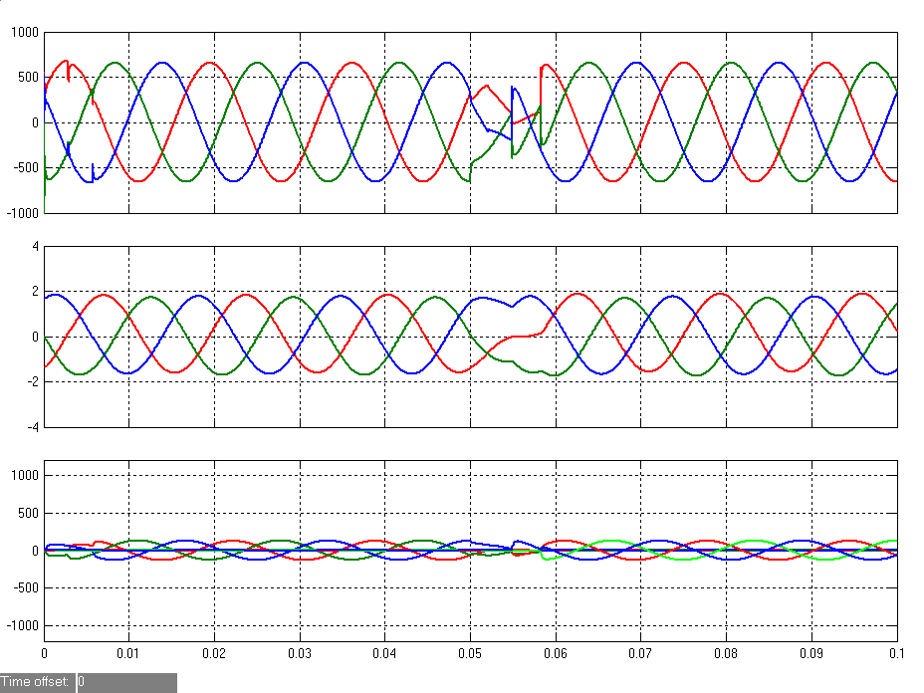
STS2 Optimized Transfer
Prevents excessive transformer saturation current
Maintains “zero” dc-flux build up during transfers
Output
Voltages
No
DC-Flux
Build up
Xfmr
Fluxes
Output
Currents

Slide 7
Optimized Transfer Performance Measures
IEEE Benchmark Systems for Static Transfer Switch 2001
Transfer time = time from detection of source failure to transfer completion (full application of the alternate source voltage)
Transfer time, as a performance measure, DOES NOT tell the whole story for the new Optimized STS
Voltages hardly disturbed
Output
Voltages
SCR Firing
Signals
Transfer Completed
Transfer Initiated

Slide 8
Optimized transfer eliminates concerns of primary side sts
Transfer reliably up to 180 degrees out of phase
Manage critical load voltage – no disturbance to the load
Control distribution transformer Flux – eliminates surge current
Ensure continuous operation of the critical load
Alternate Voltage
Load Voltage
ONLY Liebert STS2 with Optimized Transfer !
Preferred switch
Alternate switch
Temporary ON pulse
Notes:
Now we have presented how the static switch improves, reliability, flexibility and utilization: Don’t you think you have a great story for your customers. Now let me tell you about how we absolutely beat the competition,
Why we are the best.
patented technology
One key point from wave form.. Pulse Firing of the alternate source SCR’s to control the transfer and provide a seamless transition from one power source to another.
Secret sauce of static switch.
(Method 1: Phase delay, Method 2: Volt-Second Matching (PDU Transformer Flux management), Method 3: Liebert Wave shaping. Combines operating characteristics of Volt-Second Method for flux management with SCR pulse firing controls to maintain optimum RMS to prevents critical load failures.
Involves mathematical formulations to ensure the following conditions are achieved:
The temporary ON pulse does not cause the flux to move in the wrong direction and cause saturation current to flow
The temporary ON pulse should not result in delaying the occurrence of the final volt-second matching condition

Slide 9
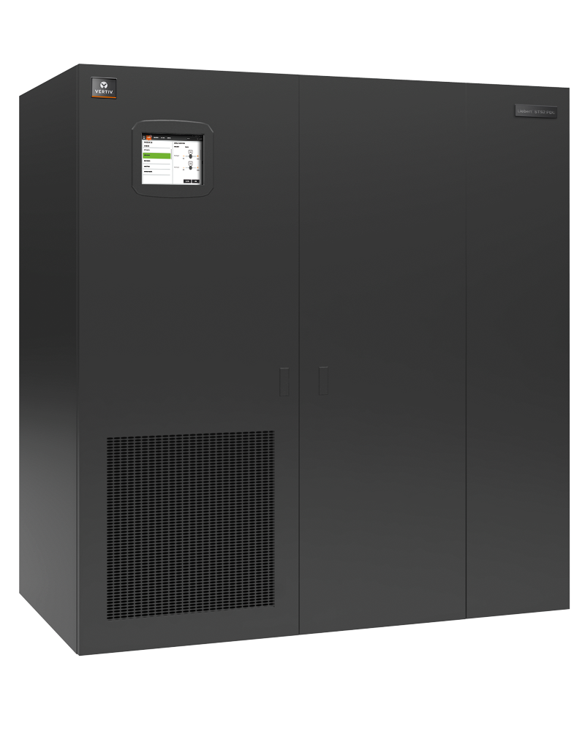
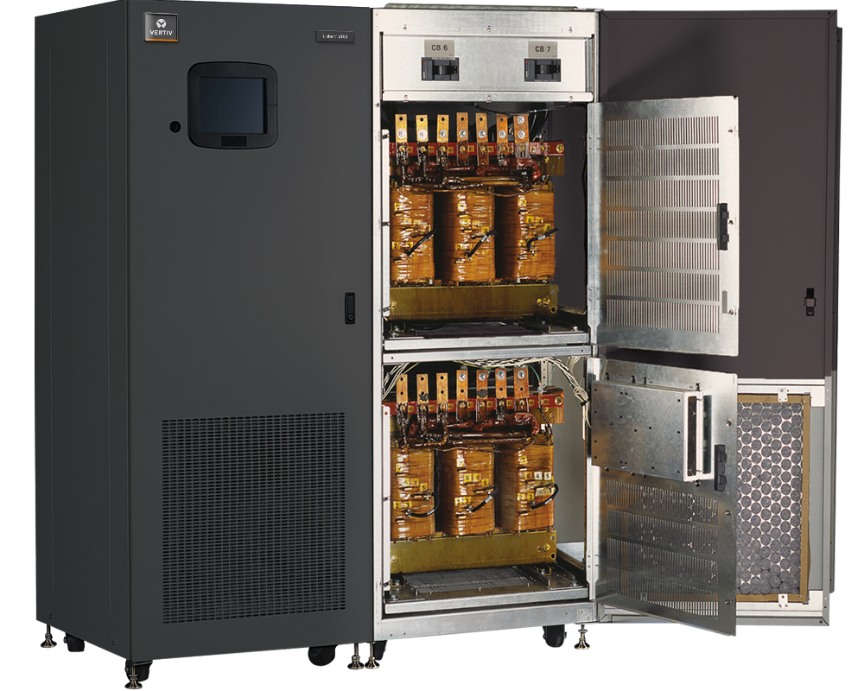
Room & Site Based Switching & distribution
Liebert STS2/PDU Static Transfer Switch (STS) with PDU
Secondary Side STS
The STS is located on the secondary-side (output) of the PDU transformers
Switching at the 208 volt level of the distribution
Ratings: 250, 400, 600, and 800 Amp
Input Voltage: 480, 600 Volts
Front-Access Only
Side access for optional distribution
Top and Bottom cable entry
Triple-Redundant Control Logic

Slide 10
power conditioning and distribution products
Static Transfer Switches
Liebert STS2
STS2 (100, 250, 400, 600, 800, 1000A)
Liebert STS2/ PDU
STS2/PDU (250, 400, 600, 800A)
Legend
In Row
Transformer Based Distribution Center
Liebert FPC
In Room
FPC (15, 30, 50, 75, 100, 125, 150, 200, 225, 300kVA )
Liebert PPC
PPC (15, 30, 50, 75, 100, 125, 150, 200, 225, 300, 430, 500, 600, 700, 800kVA)
Distribution Panel
Liebert FDC
4 x 42 Pole Panel Boards
Liebert RX
1 x 84 Pole Panel Boards
Notes:
The power distribution and switching portfolio

Slide 11
Trends: single stage power distribution?
AIR
AIR
PDU 1A
PDU 2A
Heavy Cable
Congestion Underfloor
PDU 1B
PDU 2B
IT
Rack
IT
Rack
IT
Rack
IT
Rack
Single stage distribution with panelboards located at the PDU, and typical for sizes less than 225kVA

Slide 12
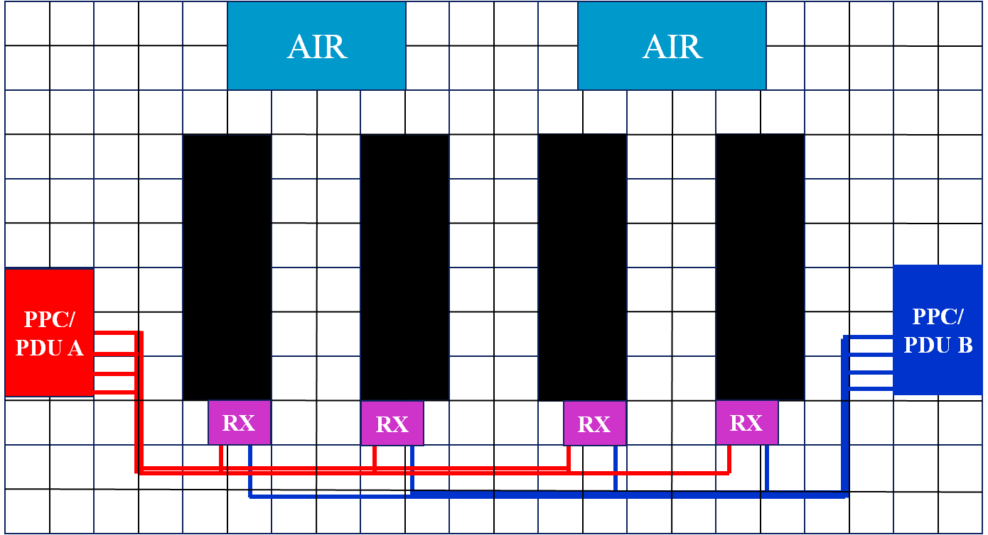
Trends: two stage power distribution?
Large data centers
Trend is from single to two stage distribution
AIR
AIR
IT
Rack
IT
Rack
IT
Rack
IT
Rack
PPC/ Outside Room
PPC/PDU A
PPC/PDU B
PPC/ Outside Room
RX
RX
RX
RX
Reduces cable congestion and opens up space for more servers

Slide 13
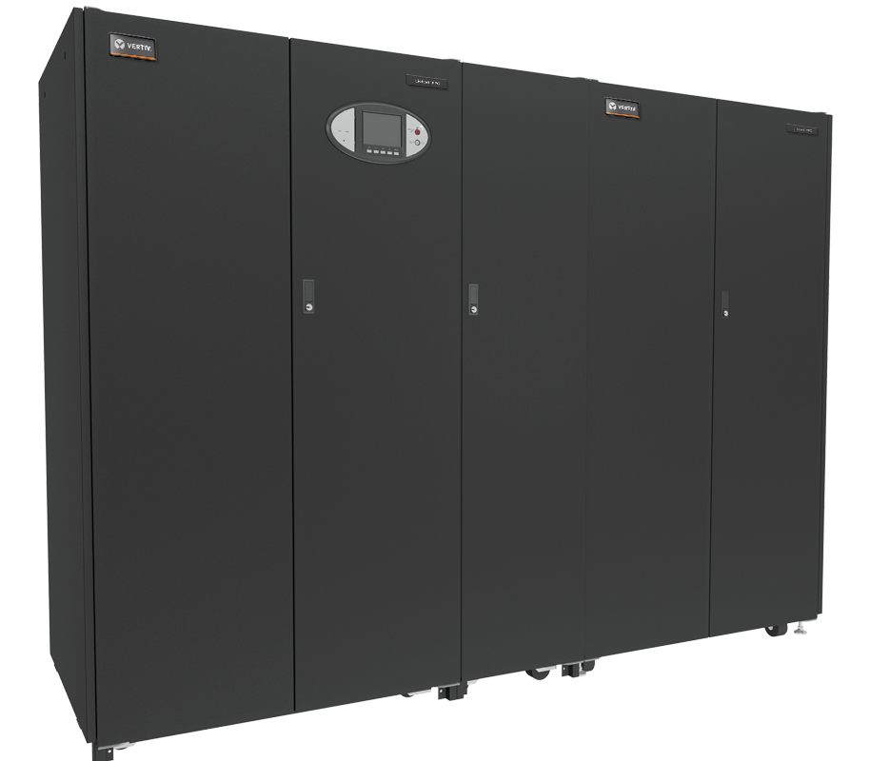
Room & Site Based Power Distribution Unit
Liebert PPC2 Power Distribution Unit (PDU)
More amps and more poles
Transformer-based design
Input voltages: 208, 240, 480, 600 Volts
Output voltages: 208/120, 240/139, and 415/240 volts
Packaged power conditioning and distribution
Provides customization options to meet application requirements
Highly efficient with DOE TP-1 transformer design
K – rated transformers available
Ratings: 15, 30, 50, 75, 100, 125, 150, 200, 225, 300, 430, 500, 600, 700 and 800 kVA

Slide 14
PPC2 150-225kVA - 44” frame Bottom Exit
Main Input Breaker
Main Input Breaker
Subfeed Breaker
(output)
Panelboard Main Breaker
Panelboard Main Breaker
72 pole SqD
54 pole SqD
Notes:
The second generation PPC can be broken down in to two functional segments. The first is 15 – 225kVA Rated units with panel board and sub feed distribution. Available with 42, 54, 72 or 84 pole panel board options. Dimensions (

Slide 15
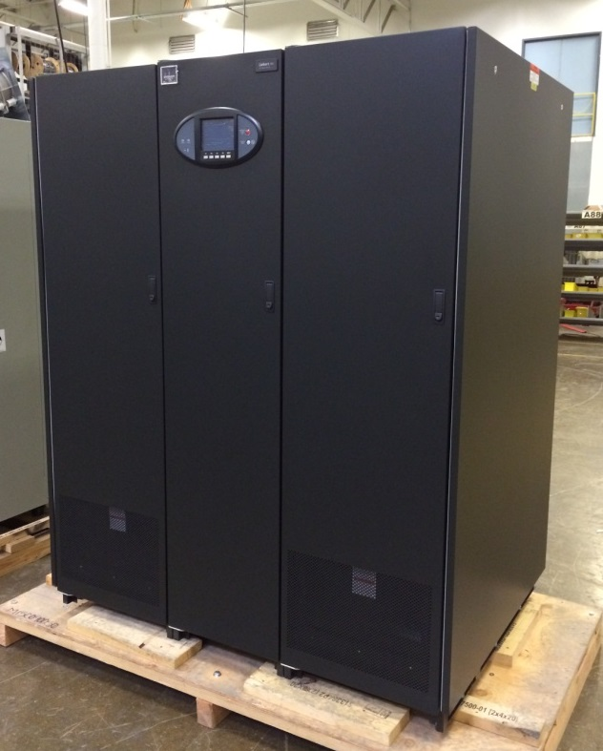
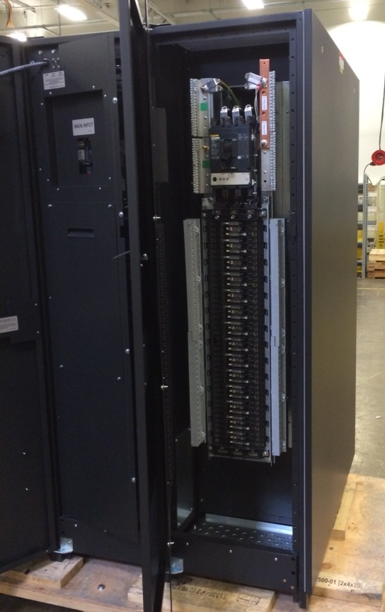
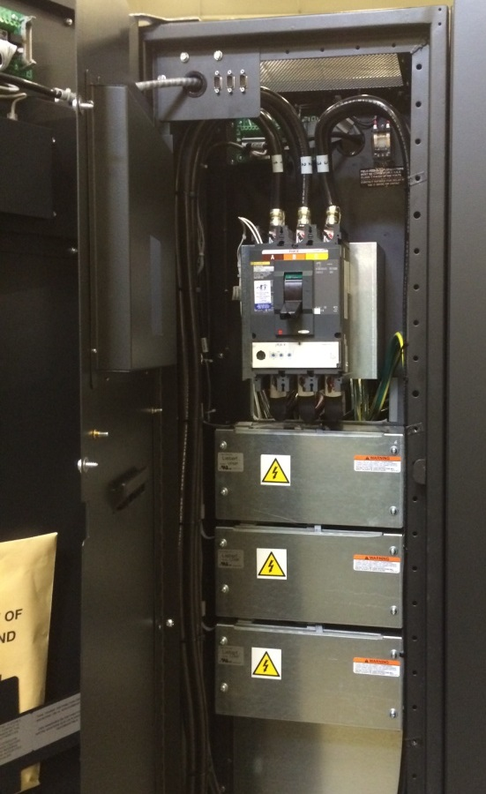
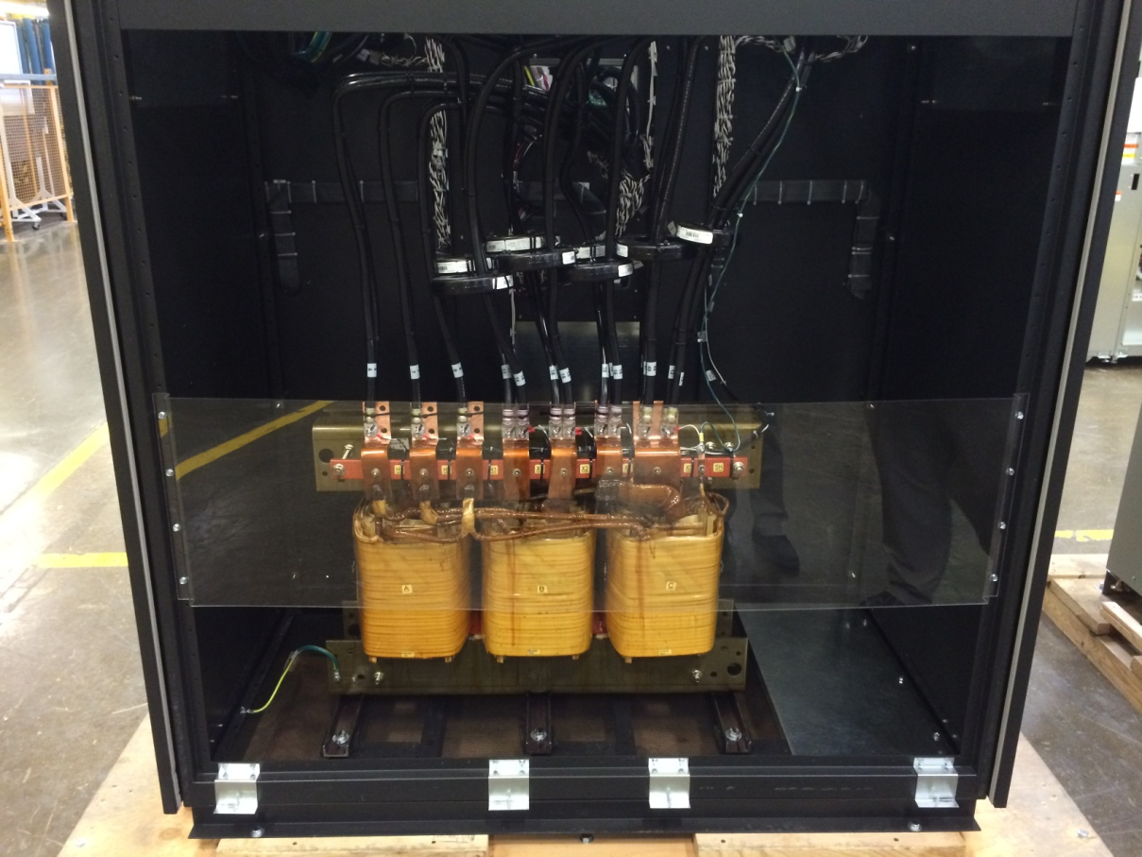
PPC-SL = a new Design
Design Elements
Smaller footprint
62”W x 45”D
Isolated panelboards and/or subfeed breakers
Front access only
Bottom entry/exit
Identical monitoring options as PPC
Available kVA ratings
300 kVA
430 kVA
500 kVA
400 – 600V input
208/120V output

Slide 16
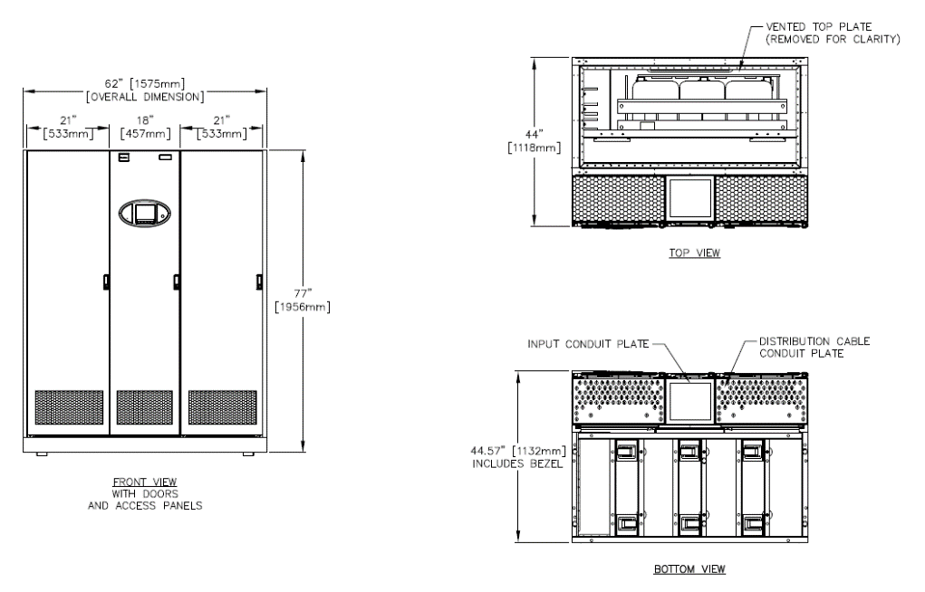
PPC SL 500KVA dimensions

Slide 17
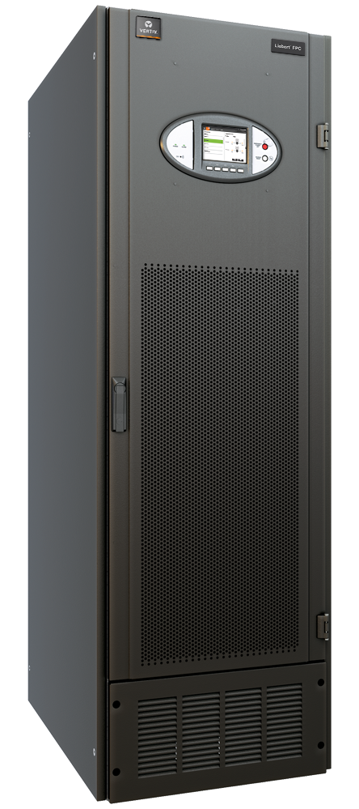
Row Based Power Distribution Unit
Liebert FPC Power Distribution Unit (PDU)
Transformer-based design
Row-Based “IT-Cabinet” design that can also be room based (*2 rack size)
2 x 42 pole in-line panel boards standard
Up to 4 x 42 pole panel boards in wide cabinet
Input Voltages: 208, 240, 480, 600 Volts
Output Voltages: 208/120, 240/139, and 415/240 Volts
Bottom and top cable entry/exit
Highly efficient with DOE TP-1 transformer design
Ratings: 15, 30, 50, 75, 100, 125, 150*, 200*, 225*, and 300* kVA

Slide 18
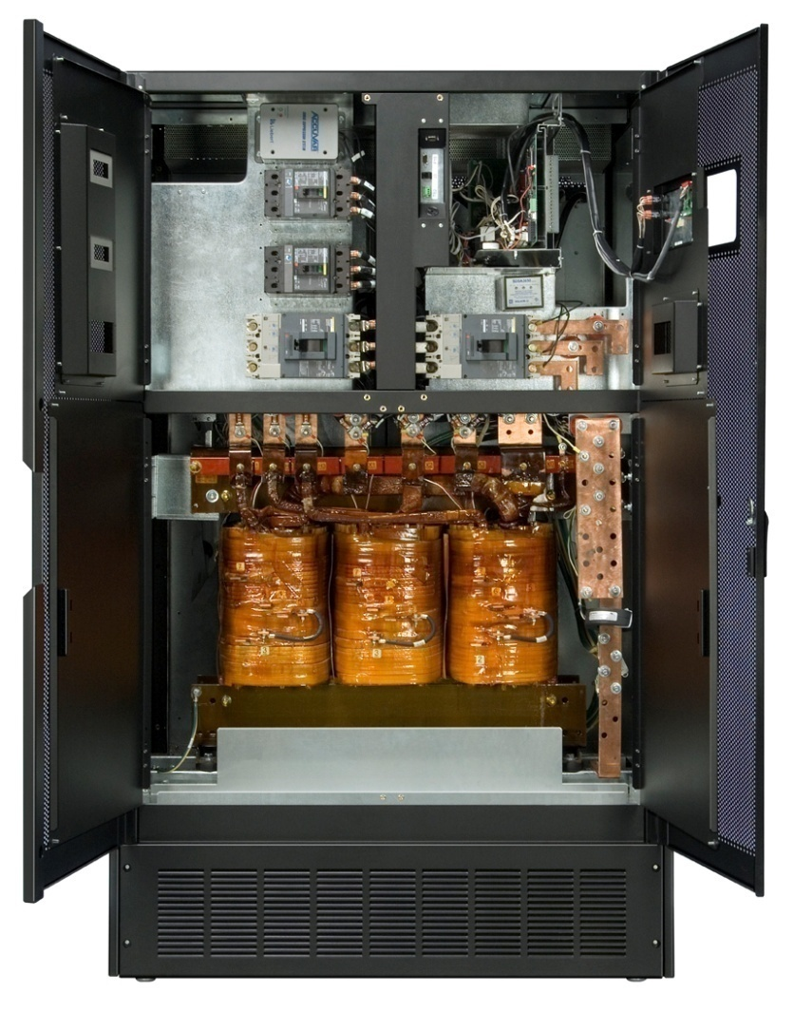
Liebert FPC
Subfeed Breakers
Main Input Breaker
PMP
Transformer

Slide 19
power conditioning and distribution products
Static Transfer Switches
Liebert STS2
STS2 (100, 250, 400, 600, 800, 1000A)
Liebert STS2/ PDU
STS2/PDU (250, 400, 600, 800A)
Legend
In Row
Transformer Based Distribution Center
Liebert FPC
In Room
FPC (15, 30, 50, 75, 100, 125, 150, 200, 225, 300kVA )
Liebert PPC
PPC (15, 30, 50, 75, 100, 125, 150, 200, 225, 300, 430, 500, 600, 700, 800kVA)
Distribution Panel
Liebert FDC
4 x 42 Pole Panel Boards
Liebert RX
1 x 84 Pole Panel Boards
Notes:
The power distribution and switching portfolio

Slide 20
Row Based remote power panels
Liebert FDC Remote Power Panel (RPP)
Transformer-less design
Row-Based “IT-Cabinet” design that can also be room based
19” width (One Rack Space)
One, two, or four inputs
Input/output voltages: 208Y/120, 220Y/127, 240Y/139, 380Y/220, 400Y/230, 415Y/240 volts
Four (4) 42-pole panel-boards with individual main breakers (168 poles)
Bottom cable entry/exit design standard
Front and rear access only

Slide 21
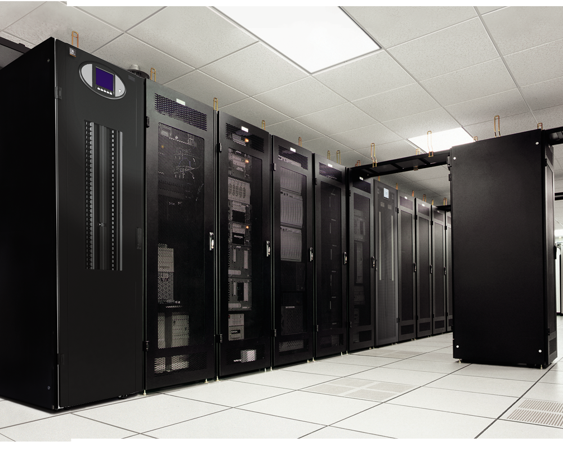
Fdc Benefits
Fills need for more branch circuits
Reduce risks associated with adding circuits
Distribution that
Is closer to the load
Is scalable
Conserves Data Center space
Is easy to install
Matches an IT cabinet rack line-up
Top or thru-side cabling capability
Integrated end-to-end power and distribution solution

Slide 22
FDC details
Power Distribution
Same size as a 19” rack
23.5”Wx38”Dx77”H
208/120V Input/output voltages
One, two, or four inputs
4 panel-boards with individual main breakers
Front and rear access only
Bottom exit standard
Monitoring options available

Slide 23
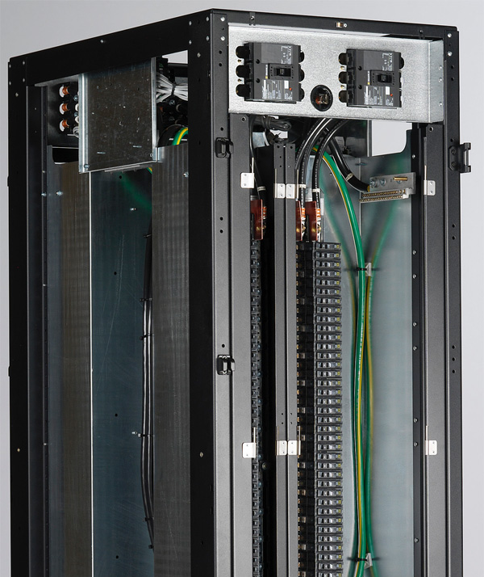
Fdc Top or Side Exit Cable Option
Cables
Cables
Cables

Slide 24
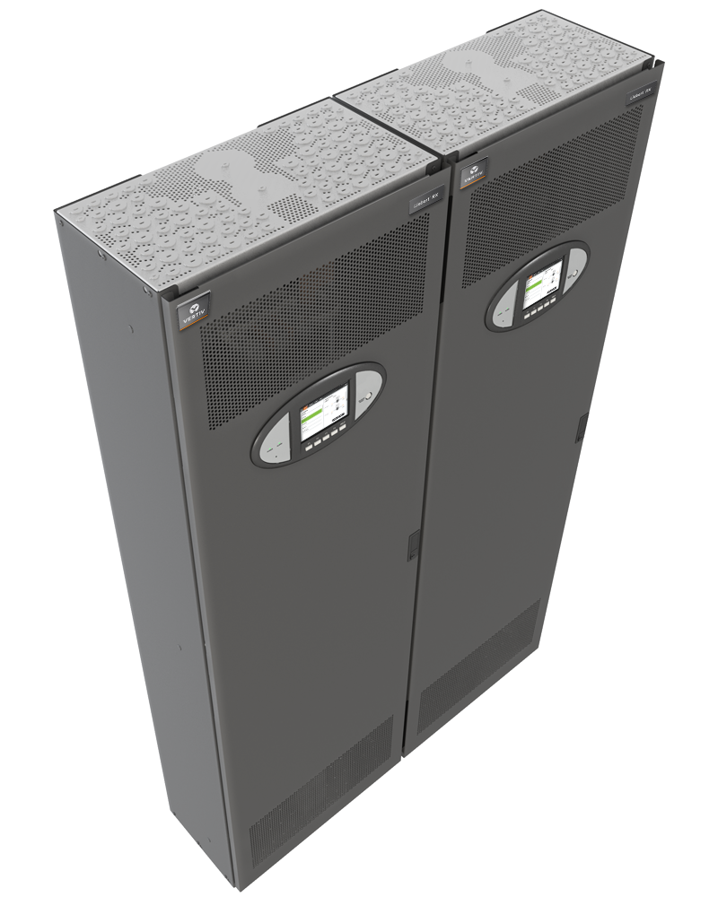
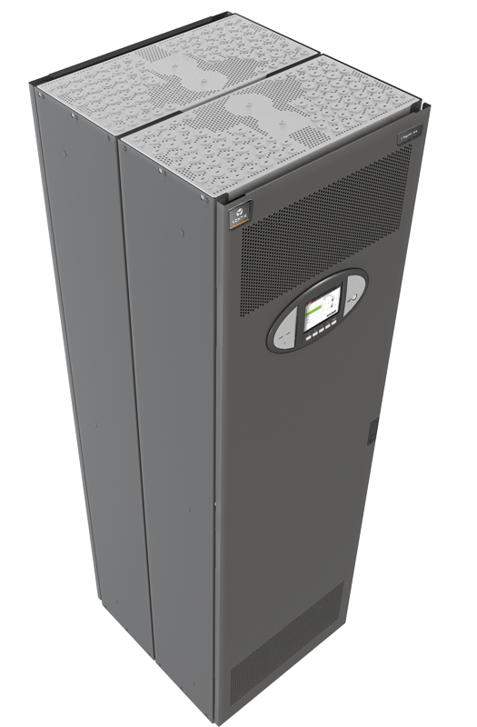
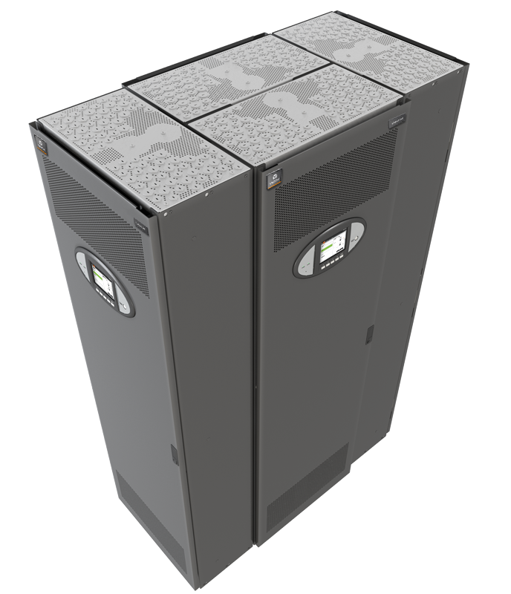
Introducing the Liebert RX
Delivering Kilowatts for Today's Servers at the Best Cost
400A, 100% rated panelboard mains
Square D 400A, 84 pole, 100% rated panelboard
Accommodates breakers from 15A 1-phase to 100A 3-phase
30 & 60A branches coordinates well with 100% rated 400 amp mains
22kAIC fault current
Frameless design for max gutter space for wire access and cooling
Meets OSHA required for total separation from energized second source
Optional panelboard main breaker or individual branch circuit metering
Top and bottom entry/exit
1, 2, 3 and 4 unit configurations
Free standing or wall mountable
Two units mounted back-to-back drop-in floor tile replacement version

Slide 25
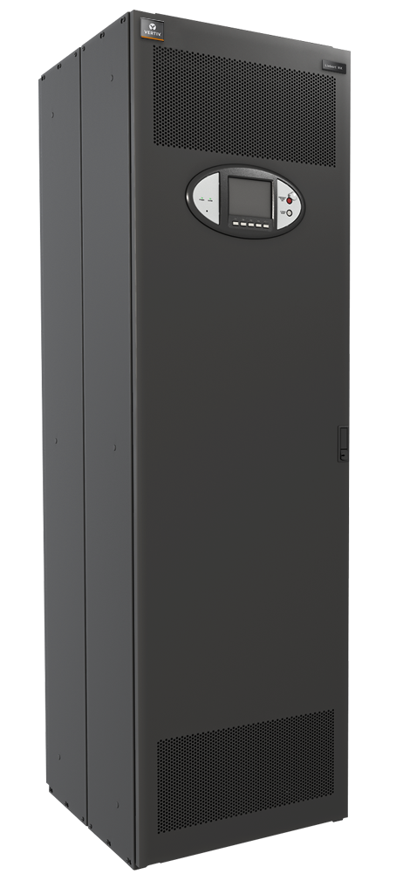
Specifications
Size - 23.75”W x 12” D x 79”H
208/120V Input/output voltage
One input
Top and bottom entry/exit
400A, 100% rated main breaker and panelboard
No panelboard main breaker option
Not needed with a single input
Eliminates breaker coordination issues
Hinged interior accent panel
Enclosure
Sold removable door
Front access
Metering Options
CPM – total current, volts, THD, etc
LDMF – individual branch, V, A ,THD, etc
100 amp CT strips

Slide 26
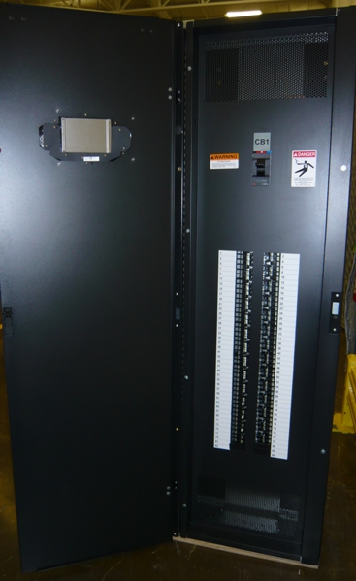
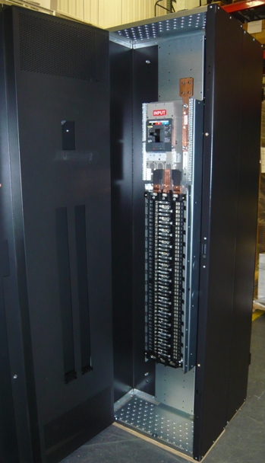
Interior photos

Slide 27
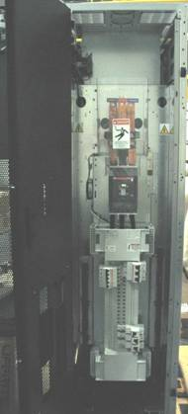
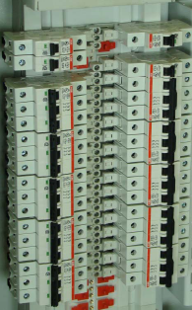
Panelboard options
Square D 400A, 208V, 22 kAIC rated 84 pole panelboard
ABB 400A, 208V finger-safe 84 pole panelboard
Square D
ABB

Slide 28
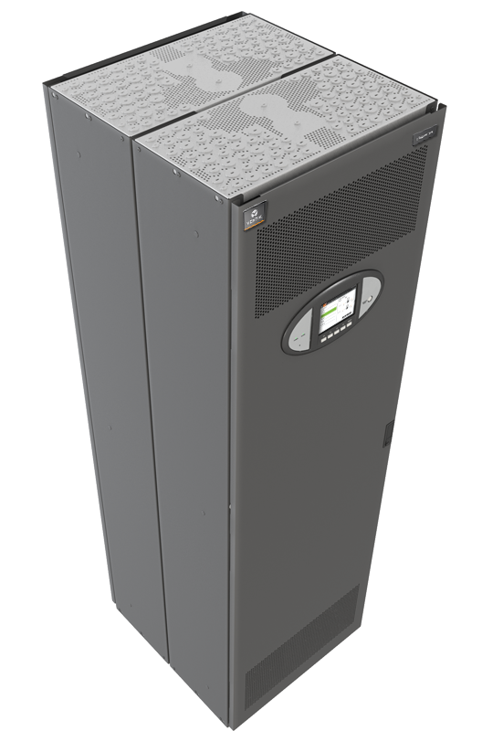
Configuration options
Single – 24”W x 12”D
Wall mounted
Back supported by column, Unistrut, Wire cage
Can not be free standing
Double - Side-by-side – 48”W x 24”D
Wall mounted
Back supported by column, Unistrut, Wire cage
Can not be free standing
Double – Back-to-back 24”W x 24”D
Free standing
Drop-in replacement for floor tile

Slide 29
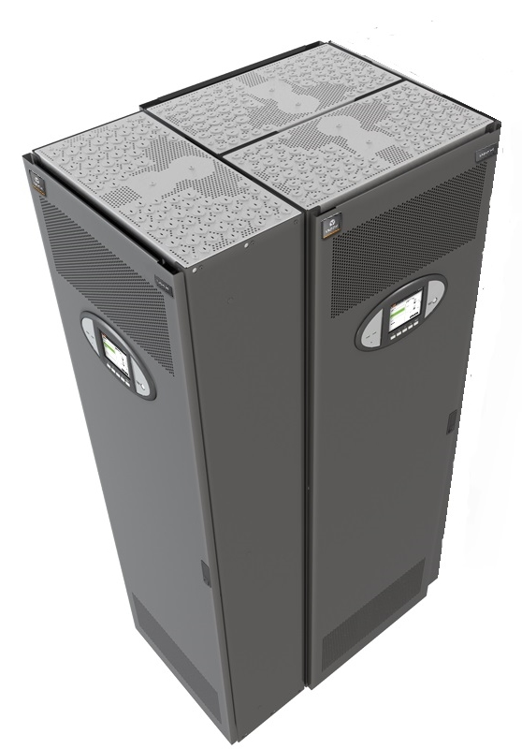
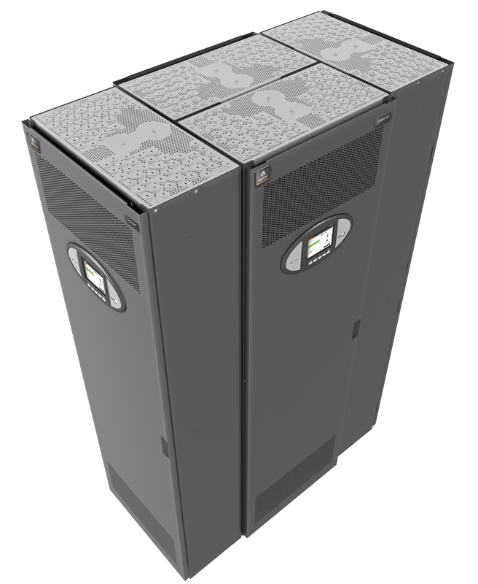
Configuration options
Free Standing – 36”W x 24”D
3 units - front, rear and one side
Free Standing– 48”W x 24”D
4 units - front, rear and both sides
Units are shipped unattached (3 per pallet)
Can be bolted together in the field by the customer to make any of the above configurations
Hardware to attach units together is supplied with each unit
Hardware to attach unit to wall or other support is supplied by others.

Slide 30
All products – monitoring capability SUMMARY
Basic Monitoring
Power Monitoring Panel (VPMP)
PDU Input/Output Level
Enhanced Monitoring Options
Current Plus Monitoring (CPM)
Panel Board Mains
Liebert Distribution Monitoring (LDMF)
CPM + Branch Circuit level monitoring
Monitoring | VPMP | CPM | VPMP+CPM | LDMF | VPMP+LDMF
Input voltage
Output voltage
Output current – total
Output current – each PB
Output current – each branch circuit

Slide 31
Current Plus Monitoring details
Monitors Panelboard Main Breaker
What is Monitored?
Phase, Neutral and Ground Current
Percent Load, Power Factor and Crest Factor
kVA, kW, kW-Hours
Voltage - Line-to-line and Line-to-neutral
Voltage and Total Current Harmonic Distortion (THD)
Alarms
Over and Under Voltage
Phase Over Current Warning
Phase Over Current Alarm
Neutral Over Current Alarm
Ground Over Current Alarm
Summary Alarm
Communications
IntelliSlot Unity Card
WEB/SNMP, Modbus 485, Modbus over IP, BACNet

Slide 32
Liebert Distribution Monitoring (LDMF) details
Reports the current level of branch breakers and panelboard main breaker
Panelboard monitoring consist of
Two current sensor modules
Each modules has 21 CT to monitor 21 branch breakers
Monitoring
Phase, Neutral and Ground Current
Percent Load, Power Factor and Crest Factor
kVA, kW, kW-Hours
Voltage - Line-to-line and Line-to-neutral
Voltage and Total Current Harmonic Distortion (THD)
Alarms
Over Current Warning
Over Current Alarm
Low Current Alarm
Communications
IntelliSlot Unity Card
WEB/SNMP, Modbus 485, Modbus over IP, BACNet
100 amp CT strip

Slide 33
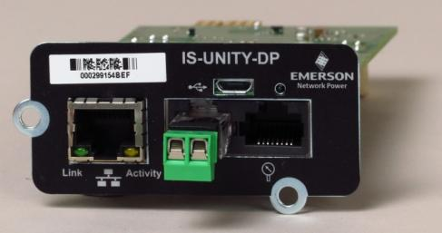
Communication & Interface Cards
UNITY Card
Supports two simultaneous 3rd party protocols
SNMP
Modbus TCP or RTU (485)
BACNet IP or MSTP (485)
Email Notifications
SMS Text Messages
HTTP Browser
LIFETM Services
SN Series sensor support
Daisy chain up to 10 together
Temperature
Temperature/Humidity
Contact Closure
Leak Detection

