Slide 1
Reasons Why Smart InfraSight Is Right For You

Slide 2
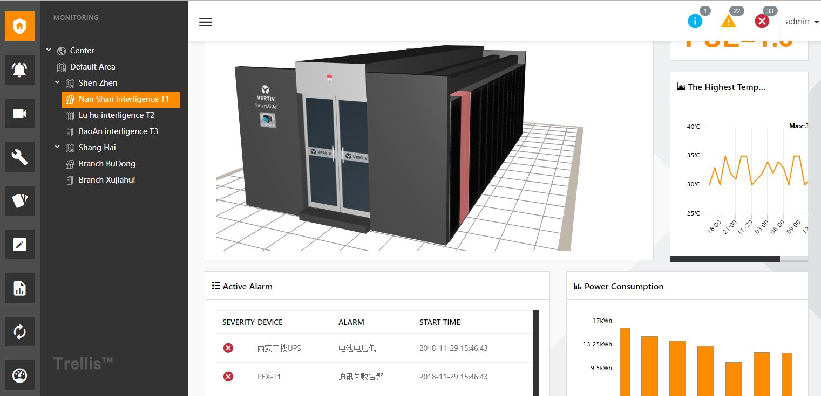
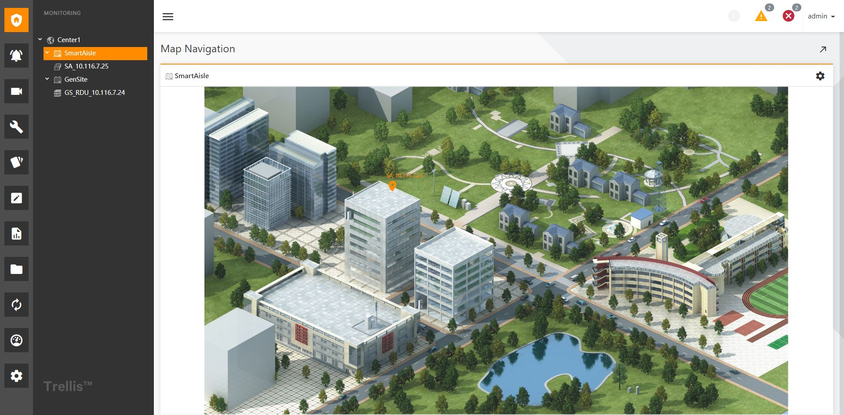
What is Smart InfraSight (SI)?
Next-gen emerging technology and solution platform for DC critical infrastructure centralized advanced monitoring.
Smart InfraSight (SI) offers opportunities for:
FAST DEPLOYMENT
ENHANCED USER INTERFACE
ADVANCED ACCESS CONTROL
INTEGRATION SIMPLIFIED
Key Benefits

Slide 3
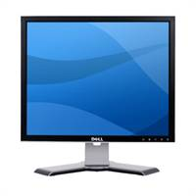
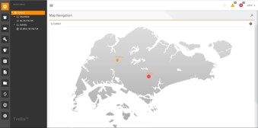
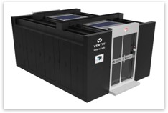
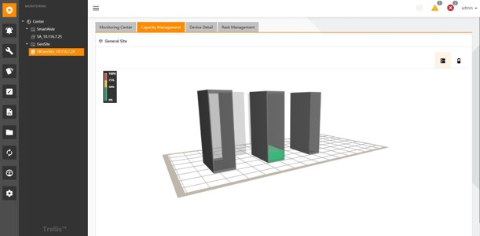
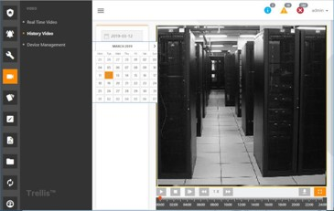
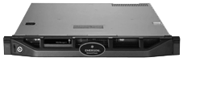
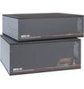
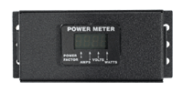
How does Smart InfraSight Work ?
Application
Smart InfraSight
Data Consumption
Multisite Capability
3D Visualization
Space/Power
Capacity Monitoring
HD Video
Surveillance
SI Capabilities
Auto-discovery
3D DC Modeling
Alert Notification
Space/Power Monitoring
PUE
CCTV & Door Access Control
REST API
Middleware & Gateway
SNMP
BacNet
Modbus
Data Collection & Gateway Management
With RDU Family
Key Benefits
Data
Collection
Equipment (Hardware)
FAST DEPLOYMENT
ENHANCED USER INTERFACE
ADVANCED ACCESS CONTROL
INTEGRATION SIMPLIFIED
Power
Cooling
IT Equipment
Battery Monitors
Meters
Sensors
Environmental Monitoring
Smart Solution
Data Center Assessment, Design and Integration Services

Slide 4
Smart InfraSight Accelerates Productivity
To optimize datacenter performance, Smart InfraSight enables data to be exported for deeper offline analysis.
Remote server power management allows for remote troubleshooting, shutdown and startup of servers.
Serial console management provides avenues for out-of-band access when network issues arise.

Slide 5
Smart InfraSight Centralizes Data Center Control
Smart InfraSight allows a single administrator to control access to multiple datacenters remotely, reducing incidences of unauthorized access.
A single operator is able to track and troubleshoot multiple sites from a single location, thanks to an intuitive interface that reduces information overload.

Slide 6
Smart InfraSight Scales Up with Business Data Center Needs
Smart InfraSight 3D modelling detects RDU gateway and attached devices and uses a simple drag-and-drop interface to quickly update the software as hardware is added.
Power, space and rack monitoring provides an easy to understand overview of the data center infrastructure, making it easy to know where to put in new servers and hardware.

Slide 7
Smart InfraSight Offers Visibility on Key Metrics
Smart InfraSight easy to understand dashboards with configurable widgets gives you all the vital metrics on a single pane of glass.
Smart InfraSight is able to drill down from an overview of multiple sites to a specific rack, giving operators real-time information on the health of the data center infrastructures.

